Slide 1
Embracing Discomfort: Learning How to Effectively Help Students with Anxiety
Kimberly Morrow, LCSW
www.Anxietytraining.com
Notes:
Warheads 10 min, Change seats, turn cell phones off

Slide 2
Speaker Disclosure:
Financial: Kimberly Morrow is in private practice. She receives a speaking honorarium from PESI, Inc. She sells courses on AnxietyTraining.com.
Nonfinancial: Kimberly Morrow is a member of the National Association of Social Workers, the Anxiety and Depression Association of America, and the International Obsessive- Compulsive Foundation.

Slide 3
Understanding Anxiety in Children and Teens
Genes, Temperament, Busy Life
Accommodations from parents/teachers
Developmental considerations
Sensitivity to anxiety
Focus on their future
Social media
Notes:
10 min

Slide 4
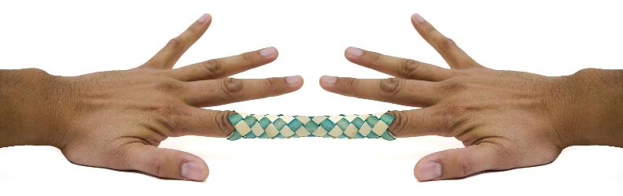
Paradox of Anxiety
Notes:
5 min The more we resist the more it persists

Slide 5
What does anxiety look like in the classroom?
Inattention and restlessness
School attendance problems and clinginess
Disruptive behavior in the classroom
Trouble answering questions in class
Frequent trips to the nurse or bathroom
Won’t turn in homework
Won’t socialize, eat in the lunchroom or participate in group
Notes:
5 min

Slide 6
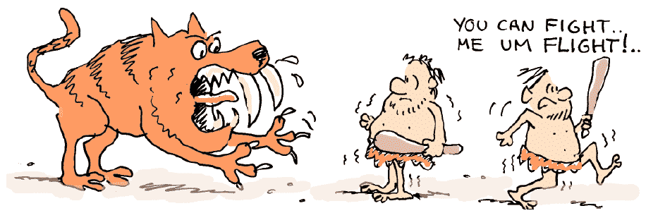
Fight or Flight: Thanking our Brain
Notes:
2 min Our brain thinks it’s helping us by keeping us from danger but it’s preventing us from living in discomfort. When we don’t take risks we don’t give ourselves the opportunity to see what’s possible.

Slide 7
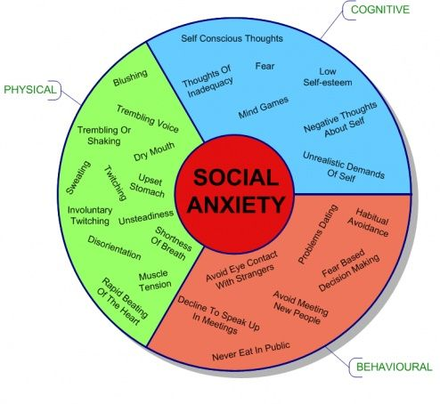
Notes:
3 min

Slide 8
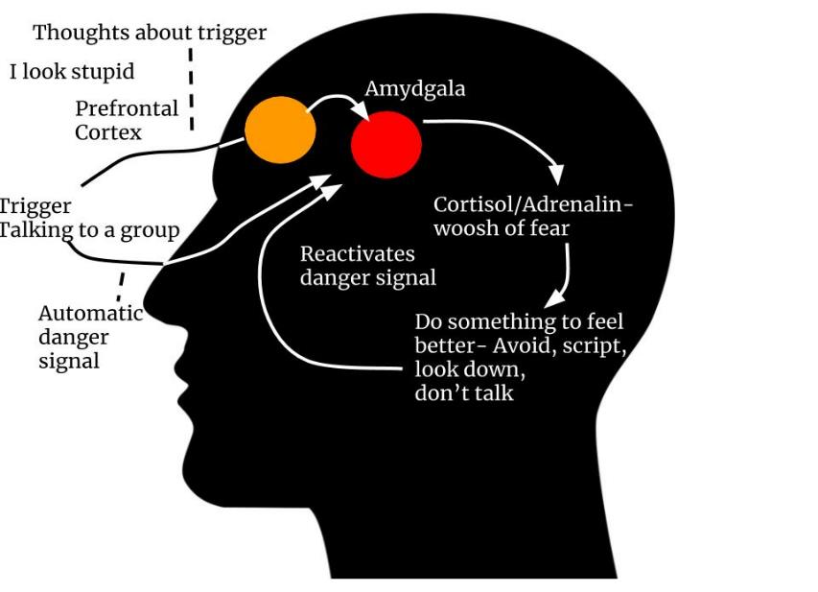
Notes:
15- min Exercise with brain

Slide 9
The Role of Medication
Selective Serotonin Reuptake Inhibitors
Benzodiazepines
Self medicating: Alcohol/marijuana
Notes:
2 min

Slide 10
Treating Anxiety
1. Education
2. Exposure and Response Prevention
3. Challenging Automatic Thoughts
4. Developing a Wellness Plan
Notes:
3 min

Slide 11
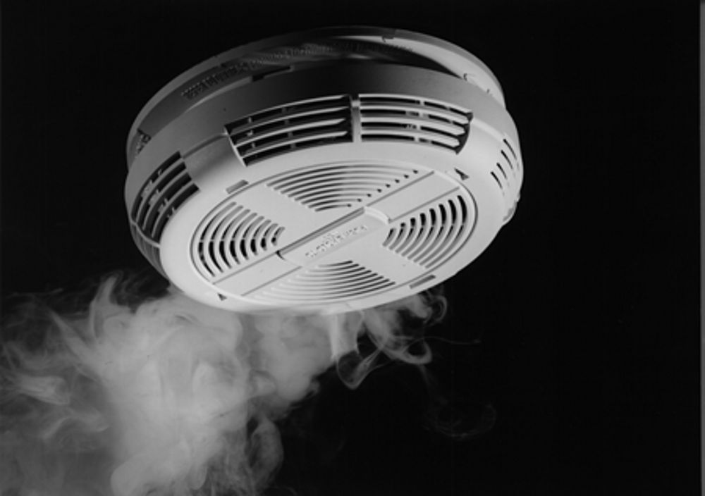
Education: Our Anxious Brain
Notes:
2 min: Bully/tomato plant

Slide 12
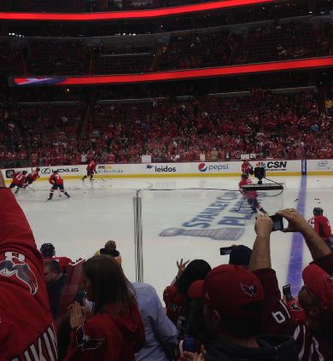
Trigger Situations
SUDS TRIGGER
10 Meeting new people
8 Eating in the cafeteria
10 Giving a presentation
7 Going to a party
6 Go to a sporting event
5 Answering the phone
9 Answering a question in class
Notes:
3 min

Slide 13
Values-They need a reason to do hard work of facing fear
What is important to me?
Sports
Friends
Family
Education
Religion
What does anxiety prevent?
Can’t go to events
No friends
Messing up family
Not in school
Can’t go to church
Notes:
2 min Go towards values not fears/experience sensations outside of yourself not fears inside your head

Slide 14
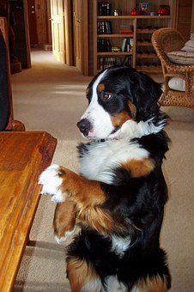
Exposure and Response Prevention
Do the thing that scares you by bringing it closer and being curious
Accept that there will always be excuses and discomfort. If you listen to them your life will be small, if you do the harder thing you will grow and learn how to handle discomfort.
Start small or go big, either way you will get better.
Trust the process: Turning towards triggers, riding the wave of anxiety, waiting to respond until wise mind shows up.
Your brain will learn what you teach it as long as you are consistent, frequent and intense
Notes:
10 min

Slide 15

Goal: To Be Effective (not symptom free)
Notes:
2 min-They are well when symptoms no longer matter. Developing resilience. Mr. Hodgsen

Slide 16
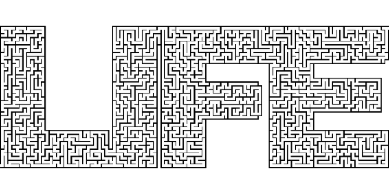
I Can Handle It!
UNCERTAINTY
DISTRESS
Notes:
3 min Uncertainty and Distress

Slide 17
Changing the way we think…
Anticipatory Anxiety
Automatic Thoughts
Cognitive Distortions
Bossing Back
Just a Thought
Bring it On
Notes:
2 min

Slide 18
Anticipatory Anxiety
The only way your brain can prevent you from going into danger
The strongest experience with anxiety is before you do the thing that causes anxiety
Tell yourself, “Of course I feel anxious, I am about to do something that is uncomfortable!”
Notes:
5 min

Slide 19
Challenging Automatic Thoughts
Getting the (wrong) information: (resistance)
      Situation: I went to the football game with some kids.
  Action: Kathy started talking to Jen and I didn’t talk.
  Automatic Thought: Talking to people sucks. I can’t do this. I look stupid. They don’t even like me.
  Feeling: I feel like an idiot. I shouldn’t have gone.
Challenging Automatic Thoughts: (acceptance)
  Rational Thought: I have difficulty talking to people. I did do this even if it felt bad and wasn’t perfect. I don’t know how I looked, I only know I felt anxious. I will have to wait to see if they like me.
  Action: I will text them and tell them I had fun with them.
  Feeling: Proud I went even though it was hard
Notes:
5 min. Example –

Slide 20
Cognitive Distortions
Just because I think it doesn’t make it true
Just because I feel it doesn’t make it dangerous
Our glitchy brains give us bad information-our mistake is taking action steps on these distorted thoughts
Our goal is to take action steps towards what we value
Notes:
5 Min Tell kids-that is just your glitchy brain sounding the alarm because something is uncomfortable

Slide 21
Bossing Back
Help them change the way they talk to anxiety so they are in the driver’s seat.
  “That’s anxiety, it doesn’t deserve a response!”
  “You’re not helping me. I’m going to ignore you.”
Change the way you talk to the student: I hope you feel anxious today! (wink, wink)
Notes:
5 min example of Jule’s teachers (imperfection/imposed time limit to study)

Slide 22
Staying present
Label
  Just a worry.
  Just a fear.
  Just a feeling.
What if…What is
  “I’m not having a conversation about the future, right now I am studying.”
  Stick to the facts not the fears
Notes:
5 min Have audience give an example-tell that story again with just the facts (Charley swim coach)

Slide 23
Bring It On!
Chase after the fear
If you want to think about it less, think about it more to teach your brain it’s just a thought and you can handle it
Be curious and bring the fear closer
“I’m going to the mall with my friends. I hope I feel anxiety because that will give me a chance to teach my brain that I can handle it!”
“I’m not going to hand in my assignment so I can learn how to handle getting into trouble!”
Notes:
5 min- 2nd grader with fear of getting in trouble

Slide 24

Climb Over Obstacles
Don’t wait for it to feel better…..
Identify the obstacles and help them to climb over
Notes:
5 min Emma/panic ( my office: face time, the car: sessions in car, history class: meet the teacher/classroom)

Slide 25
Safety Behaviors
Help them to stop using these:
  Going to the bathroom multiple times
  Avoiding eye contact
  Texting their parent in class
  Avoiding
  Going to the nurses office
  Washing their hands over and over
  Asking the same question multiple times
  Seeking reassurance
Notes:
10 min

Slide 26

Relaxation: Helpful or Hurtful?
Notes:
5 min : Demonstrate breathing with longer exhale

Slide 27
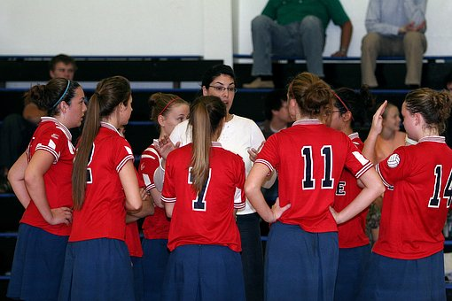
Coaching

Slide 28
Coaching Steps
Do not reassure someone who is anxious, instead validate how they are feeling and help them tolerate the distress until they are on the other side.
Instill in them your belief that they can handle feeling bad.
Celebrate trying and any step they make towards handling the feelings.
Help them face their fears and be courageous.
Don’t connect to content.
Stay in the doubt (maybe, maybe not…I don’t know)
Answer questions one time to provide information not reassurance.
Notes:
10 min –coaching handout

Slide 29
Develop a Wellness Plan
Our brains need a rest….
What keeps me well?
Why am I doing _________?
Practice wellness consistently, not in response to anxiety. (can class begin with this?)
  Exercise
  Yoga
  Mindfulness
  Meditation (Headspace, Buddhify)
  Talking in a healthy way to ourselves (Woebot)
Notes:
5 min Pay attention to intention

Slide 30

II. Developing Strategies

Slide 31
Facing Panic
Educate student about anxiety and the brain
David Carbonell (anxietycoach.com) A.W.A.R.E.
Use senses to stay grounded
Engage in conversation while tolerating the symptoms
Notice the time-15 min rule
Interoceptive Treatment to induce panic symptoms
Breath-longer exhale
Healthy self talk
Know the anatomy of a panic attack (see handout)
Move-take a walk but return to the classroom
Notes:
10 min Panic handout/ Straw breathing/anatomy of panic

Slide 32
A.W.A.R.E.
Acknowledge & Accept (most important)
Wait & Watch (gather info, return to task)
Actions(Belly breathe, self talk, sensations)
Repeat
End
Difference between being afraid and being in danger.
Notes:
5 min

Slide 33
Social Anxiety: Tolerating Embarrassment
Exposure to embarrassing experiences or places where they may be negatively evaluated
Social mishap exposures
  Ask a stranger for directions
  Ask for directions to a room you are standing right in front of
  Text something to the wrong person
  Practice giving wrong answer in class
Challenge beliefs about what other people think of you (get facts not fears)
Reward students who try and struggle
TedX: Till Gross-How to Become More Confident in 30 Sec
Notes:
15 min. Ask to meet and discuss a case and how they might help (practice laying down for 30 sec-take a pic and share)

Slide 34
School Refusal
Teach everyone about anxiety and the brain!
Team approach
Psychological assessment-other problems?
Small steps (be creative and flexible with solutions)
Get them involved in an activity they like
Ask teacher to be a mentor
Begin where they can be successful
Involve friends to text/show up
The longer they are out of school the harder it is
Notes:
10 min: Example of Connor and the school meeting

Slide 35

Test Anxiety
Over prepare
Don’t compare
Good self talk
Loving kindness
Practice timed tests
Notes:
5 min Mr. Hodgsen

Slide 36
Obsessive-Compulsive Disorder
Obsessions: intrusive images or fears
Compulsions: anything you do to feel better
What it may look like in school:
  Reassurance seeking
  Perfectionism
  Re-reading/rewriting
  Asking questions over and over
  Checking
  Extensive hand washing
  Avoiding
Notes:
15 min Ask to meet and discuss a student-tell them sample accommodations are on next pp slides

Slide 37
How to help students with OCD
Accommodations can be helpful until they begin ERP therapy:
Seating arrangement: Ask the child where they prefer to sit.
Extended time for tests and papers: If writing is a problem for a child who needs to find the perfect way to say something, he’s going to need more time to finish those essay questions or papers.
Laptops for writing: If writing and rewriting/erasing is really problematic for a child, consider letting her use a laptop for taking notes, and having all assignments be typed instead of handwritten.
Private testing rooms: Research is quite clear that kids with OCD do better, are less overwhelmed and are more in control of their thoughts and their reactions if they’re in a quiet place away from the other kids.

Slide 38
Helping students with OCD
Skip reading out loud: Kids who feel they need to read perfectly may have to go back and reread sentences or whole paragraphs over and over to make sure they’ve got them right. So reading becomes a very laborious task, and reading in front of the class can become a nightmare. So if we know doing this is a problem for children, we can spare them.
Books on tape: If kids get so hung up reading that it takes forever, listening to the books can be a solution.
Break homework into chunks: If looking at a whole page of math makes kids feel overwhelmed and anxious — think of the potential for mistakes! — the problems can be broken up over four pages. It helps kids stay focused on doing the problems instead of worrying.
Our goal is to use exposure therapy for each student with OCD to eventually face their fears and handle these triggering situations without accommodations.

Slide 39
PANS or PANDAS
Pediatric Acute-Onset Neuropsychiatric Syndrome (associated with Strep) (1 in 100 children)
Strong stimulant (strep, flu, virus, lyme) to the immune system
Creates an inflammatory response in the basal ganglia
“Exact Date” Anxiety/OCD
Symptoms include severe anxiety (worries, separation, OCD)
Along with: reading/writing difficulties, tics, eating disorder, personality change, irritability/aggression, developmental regression
See handout
Notes:
5 min Review handout

Slide 40
Generalized Anxiety Disorder
These are the worriers.
They fear not being able to handle bad things in the future.
They may ask questions over and over: Give them pennies. When they run out of pennies, they cannot ask more questions.
They may seek reassurance: Reassure them one time and then redirect them and don’t keep talking with anxiety.
Have them write a fear script and coping script and record it into their phone. Listen to this several times a day.
Help them tolerate uncertainty: Maybe…maybe not.
Encourage them to believe they can handle the outcome.
Teach these kids to practice presence-worry lives in the future.
Notes:
15 min Role play student with GAD- have them each write a fear/coping script

Slide 41
Fear vs Coping Script
FEAR:I wake up in the morning and I remember what happened yesterday. Julia made fun of me in front of everyone. I was mortified. I don’t want to go to school today. I stay in bed, hoping my parents won’t make me go. I turn off my alarm. I try to go back to sleep so I don’t have to face the day but I lay there worrying about what everyone is thinking.
COPING: I wake up in the morning and I remember what happened yesterday. Julia made fun of me in front of everyone. I feel anxiety in my stomach and I wish I didn’t have to go to school today. But today I will not let my anxiety or Julia keep me from doing what is important to me. I have a track meet tonight. I need to go to school so I can run in the meet. Running with my friends is more important than anxiety or Julia. I’m getting up now, eating a healthy breakfast and will listen to my playlist that makes me feel awesome! Julia has no power over me.
Notes:
5 min -have them each write a fear/coping script

Slide 42
Targeted Anxiety Treatment Group
Identify anxious students that are not benefitting from universal support strategies with teachers/counselor
Develop program to teach skills and provide peer support
Identify day/time to provide program
Include parents for a psychoeducation program
Notes:
10 min Just gave to Emma to do as a part of psychology class project-gets a credit for this

Slide 43
Resources
SCARED Anxiety Assessment: http://www.midss.org/content/screen-child-anxiety-related-disorders-scared
Noises in Your Head Free Video Series
Till Gross-Ted x talk: How to Become More Confident
Mark Freeman-The OCD Stories on YouTube
AnxietyCoach.com
Woebot app-to help you get through challenging situations
Headspace app-meditation
Coaching Handouts
Anatomy of a Panic Attack Handout
https://childmind.org/guide/a-teachers-guide-to-ocd-in-the-classroom/
PANDAS and PANS Essential Facts for Teachers Handout
Notes:
5 min

